Slide 1
MACHINE LEARNING PROJECT • REGRESSION ANALYSIS
Student Final Exam Score Prediction
Using Linear Regression
NAME
BRANCH
ALGORITHM
INPUT → TARGET
Rohit Pandey - 27
Ashish Pandey - 26
Computer Science & AIML
Linear Regression
Study Time (hrs) → Exam Score
1
2
3
Study Time
(Input Feature)
Linear Regression
Model
Predicted Exam
Score (Output)
A supervised regression model that estimates a student's final exam score from hours studied

Slide 2
Problem Statement & Dataset
DATASET AT A GLANCE
Can we predict a student's final exam score based on the amount of time they spend studying?
1,000
12
Total Records
Total Columns
Supervised Machine Learning — Regression problem
Goal: understand the relationship between study time and exam performance
The model learns this relationship from historical student data and predicts a numerical score
0
102
Duplicate Rows
Missing Values
(parental_education)
1,000
Variable | Type | Role
study_time_hours | Numerical | Input
final_exam_score | Numerical | Target
Rows Used After
Feature Selection
Note: the full dataset has 12 columns, but this model uses only one input feature — study time.

Slide 3
Data Preprocessing & Model Training
CSV Dataset
Data
Inspection
Feature
Selection
Train/Test
Split
Model
Training
PREPROCESSING STEPS
MODEL: LINEAR REGRESSION
Dataset loaded using Pandas
Checked dataset structure, columns, and missing values
Selected study_time_hours and final_exam_score
Removed missing values using dropna()
Split data: 80% training (800 samples), 20% testing (200 samples)
Used random_state=42 for reproducibility
y = mx + c
y
predicted final exam score
x
study time
m
slope / coefficient
c
intercept

Slide 4
Model Performance
MAE
MSE
RMSE
R²
6.91
74.58
8.64
0.31
Predictions differ from the actual score by ~6.91 points on average
Mean squared error across the test set
Typical error, with larger errors penalized more strongly
Study time alone explains ~31% of score variation
Final Exam Score = 3.99 × Study Time + 69.45
Slope = 3.99
Intercept = 69.45
For this fitted model, an additional hour of study time is associated with an estimated 3.99-point increase in predicted exam score — this reflects an association, not proof of a causal effect.

Slide 5
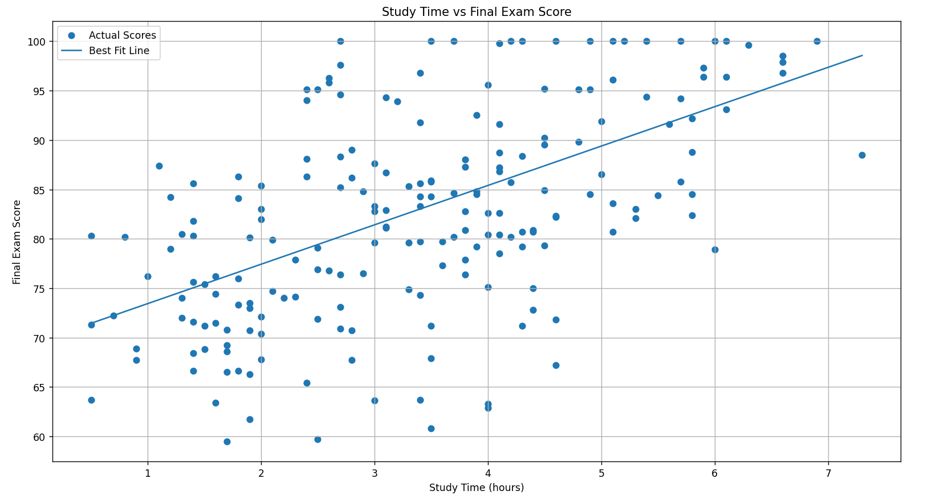
Prediction, Visualizations & Conclusion
Study Time
= 2 hours
Linear
Regression
Model
Predicted Score
= 77.42
Trained model saved as student_score_model.pkl
Study Time vs Exam Score
Actual vs Predicted Score
Linear
Regression
→
Random
Forest
→
Decision
Tree
→
Gradient
Boosting
CONCLUSION
Complete basic ML regression workflow demonstrated
Trained on 1,000 student records
R² = 0.31 — study time alone gives limited explanation
Model generates predictions for new study-time values

